Slide 1

Vel Tech Rangarajan Dr. Sagunthala R&D Institute of Science and Technology
School of Computing
Department of Computer Science and Engineering
10211CS224 / FULL STACK APPLICATION DEVELOPMENT (JAVA)
PROJECT REVIEW : MILESTONE PROJECT – 1
Date: 24 - 03 - 2026
SUBSCRIBTION-BASED MEMBERSHIP ENGINE WITH TIERED LOGIC
SDG: SDG No : 9 – Industry,Innovation,Infrastructure
Presented By:
R.BALAPOOJITHA – VTU24951– Reg.No.23UECS0863
Courses Handling Faculty:
Dr. Hafizur Rahman- Assistant Professor

Slide 2
INTRODUCTION
1
Many organizations use subscription models to provide services such as online learning, streaming, software access, and membership-based platforms.
In traditional systems, membership details, subscription plans, and payment records are often managed manually or with basic tools.
Manual management may lead to errors, data duplication, difficulty in tracking subscription validity, and inefficient handling of user information.
There is a need for an automated system that can manage memberships accurately and reduce manual effort.
This project is important because it helps organizations manage different subscription levels using tiered logic such as Basic, Standard, and Premium plans.
The system has real-world relevance as many businesses rely on subscription-based services to improve customer engagement and revenue.
The proposed system allows users to register, log in, select subscription plans, and access features based on their chosen membership level.
The application uses full stack technologies to securely store user data, manage subscriptions efficiently, and provide a simple and user-friendly interface.
2
3
4
5
6
7
8
9

Slide 3
PROBLEM STATEMENT
Many organizations manage membership and subscription details manually or using basic systems.
Manual handling of user data, plan selection, and payment tracking can lead to errors and inefficiency.
Existing systems often lack proper automation for managing different subscription tiers and user access levels.
Difficulty in tracking subscription validity and renewal dates may result in poor user experience.
Managing multiple membership plans without a structured system can cause data inconsistency and confusion.
Businesses require a reliable system to securely store and manage customer subscription information.
There is a need for a centralized platform that simplifies membership management using tiered logic.
Therefore, an automated Subscription-Based Membership Engine is required to improve efficiency, accuracy, and service quality.
1
2
3
4
5
6
7
8
9

Slide 4
OBJECTIVE(S)
1
To design and develop : A full stack web-based Subscription-Based Membership Engine that allows users to register, log in, select tiered plans (Basic, Standard, Premium), and manage their membership details efficiently.
To implement and improve : Automated tiered logic for controlling user access, managing subscription validity, and securely storing membership data to enhance accuracy, performance, and user experience.
2
3
4
5
6
7
8
9

Slide 5
PROPOSED SYSTEM
1
The proposed system is a full stack web application that automates the management of subscription-based memberships.
It allows users to register, log in, and select subscription plans such as Basic, Standard, and Premium based on their requirements.
The tiered logic controls user access to features depending on the selected membership level.
The system securely stores user information, subscription details, and plan validity in a structured database.
It reduces manual errors and improves efficiency by automating plan selection, renewal tracking, and data management.
The application provides a user-friendly interface for both users and administrators to manage memberships easily.
Compared to traditional systems, it offers better accuracy, faster processing, and improved data organization.
The system is scalable, reliable, and can be extended to support various real-world subscription-based services.
2
3
4
5
6
7
8
9

Slide 6
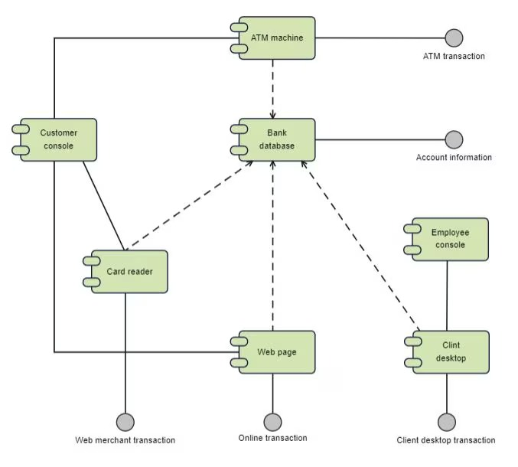
PROPOSED SYSTEM ARCHITECTURE
Input :
Registration information (name, email, password).
Login credentials.
Selection of subscription plan (Basic, Standard, Premium).
Payment details (if applicable).
Processing :
Validating user details during registration and login.
Applying tiered logic to determine access level.
Managing subscription activation and renewal.
Ensuring secure communication between frontend and database.
Database :
User account details.
Subscription plan information.
Payment records.
Access permissions based on tier level.
Output :
Successful registration or login confirmation.
Display of available subscription plans.
Reports or dashboard for admin users.
1
2
3
4
5
6
7
8
9

Slide 7
WORKFLOW
USER
│
▼
[1. Register / Login]
│
▼
[2. Select Subscription Plan]
│
▼
[3. Payment Processing]
│
▼
[4. Payment Verification]
│
▼
[5. Update Subscription Tier]
│
▼
[6. Store Data in Database]
│
▼
[7. Access Control (Tier Logic)]
│
▼
[8. Provide Services / Features]
│
▼
USER
1
2
3
4
5
6
7
8
9

Slide 8
TECHNOLOGIES USED
Frontend:
HTML5.
CSS3.
JavaScript (ES6).
Backend:
Java (Spring Boot).
Database:
MySQL.
Tools:
VS Code / Eclipse.
Postman (API testing).
Git (version control).
XAMPP / Tomcat Server.
Hardware Requirements:
Laptop/Desktop.
Minimum 4GB RAM & Internet connection.
Software Requirements:
JDK 8 or MySQL Server.
Web Browser.
Operating System (Windows/Linux).
1
2
3
4
5
6
7
8
9

Slide 9
MODULE DESCRIPTION
1
Module 1: User Management
This module allows users to create an account, log in, and manage their profile details. It ensures secure authentication so that only registered users can access the system.
Module 2: Core Processing
This module shows different membership plans such as Basic, Standard, and Premium. Users can select or change plans based on their needs, and the system controls access using tiered logic.
Module 3: Database Management
This module stores and manages all data such as user details, subscription plans, and membership validity. It ensures data is stored securely and can be retrieved easily when needed.
Module 4: Reporting & Analytics
This module helps the admin monitor user subscriptions and view important information. It can display simple reports such as number of users and selected membership plans for better management.
2
3
4
5
6
7
8
9

Slide 10
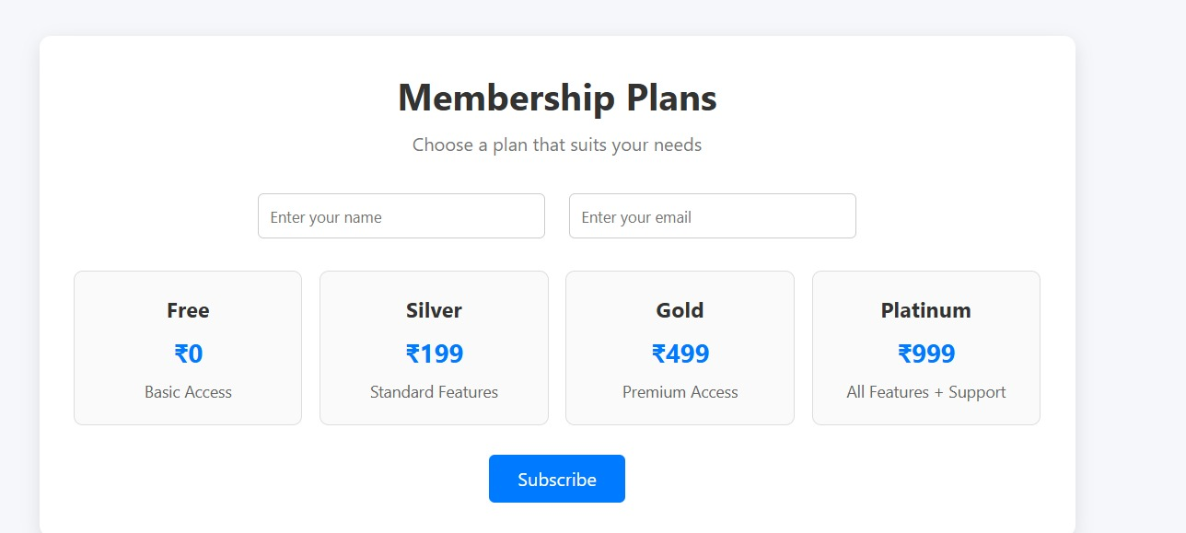
IMPLEMENTATION SCREENSHOTS
1
2
3
4
5
6
7
8
This is a clean and modern membership subscription page where users can enter their details and select a plan (Free, Silver, Gold, Platinum).
It provides an interactive UI with tier-based pricing and a subscribe option for dynamic user registration.
9

Slide 11
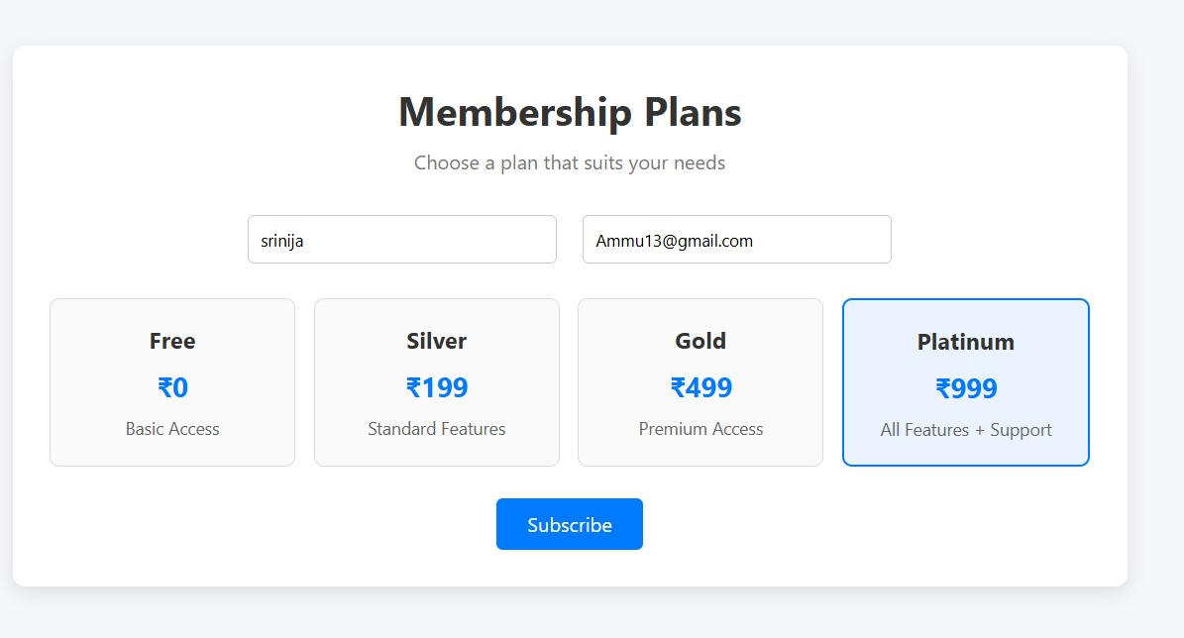
IMPLEMENTATION SCREENSHOTS
1
2
3
4
5
6
7
8(A)
This interface shows a user filling in details and selecting the Platinum membership plan, which is highlighted for clarity.
It demonstrates an interactive subscription system where users choose a tier and proceed with registration.
9

Slide 12
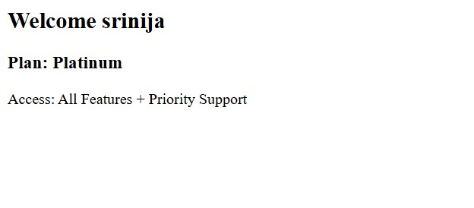
IMPLEMENTATION SCREENSHOTS
1
2
3
4
5
6
This premium tier provides full access to all features along with priority support.
This status ensures the user receives the fastest possible assistance and the most comprehensive toolset available.
7
8(B)
9

Slide 13
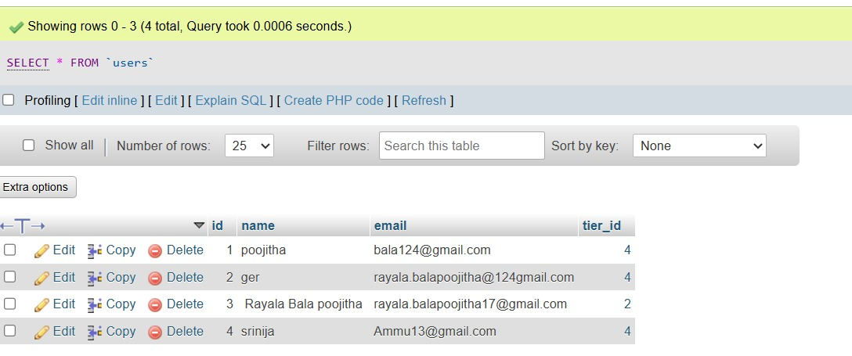
IMPLEMENTATION SCREENSHOTS
1
2
3
4
5
6
7
8(C)
A phpMyAdmin interface showing the results of a database query for a table named users. It contains four entries with columns for ID, name, email, and tier_id, including the user "srinija" seen previously.
The data reveals that different users are assigned specific numeric tiers, likely corresponding to their subscription levels like the Platinum plan.
9

Slide 14
ADVANTAGES & LIMITATIONS
1
ADVANTAGES :
Reduces manual work by automating membership and subscription management.
Provides different membership levels (Basic, Standard, Premium) using tiered logic.
Improves accuracy in storing and managing user data.
Easy to use interface for both users and admin.
Saves time by automatically handling registration, login, and plan selection.
Helps businesses efficiently track subscription validity and renewals.
Limitations:
Requires internet connection to access the system.
Initial setup and configuration may take time.
Security depends on proper implementation of authentication methods.
Limited features in the basic version of the system.
Payment integration may need additional configuration.
System performance depends on server capacity.
Regular updates may be required to improve functionality.
2
3
4
5
6
7
8
9

Slide 15
Thank you

